Slide 1
COVID -19 Pandemic Data Analysis
( Data Science Project )

Slide 2
Attributes of the project
How the pandemic unfolded in the countries where lockdown was implemented quickly as compared to where to countries where stringency wasn’t at a 100% capacity.
Using the datasets from Kaggle.
Training a model to predict the outcome of the pandemic
Interactive Plots for better data visualization of the COVID – 19 pandemic.
Implementation of ‘ggplot2’ and ‘gganimate’ libraries.

Slide 3
Using Linear Regression for predicting the fatalities

Slide 4
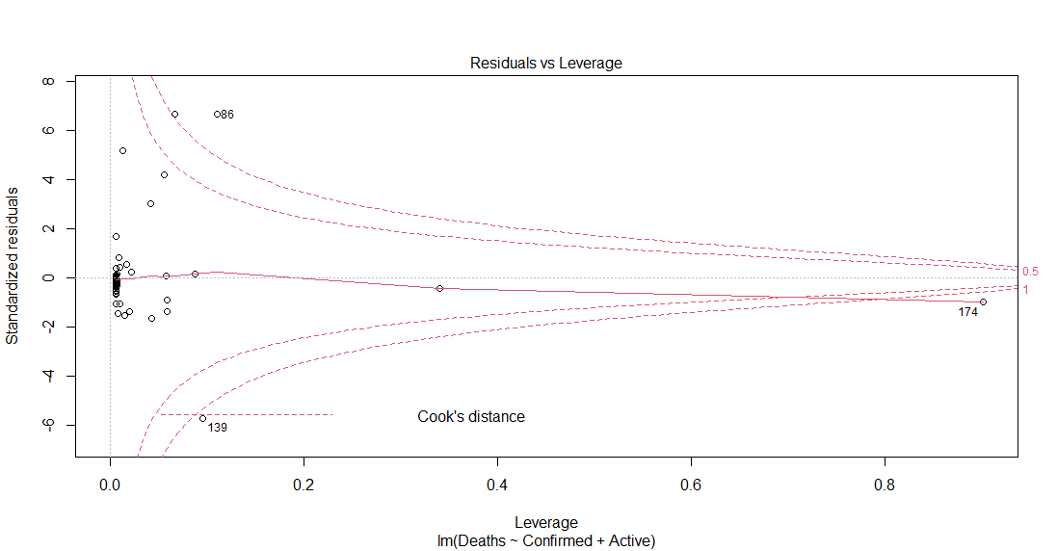
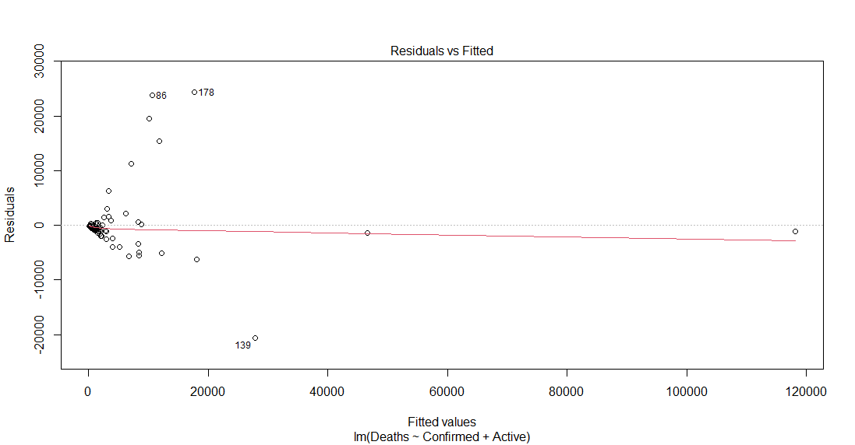
Analysis of Residual Plots

Slide 5
Principal Component Analysis
(Using Corrgrams and Corrplot)

Slide 6
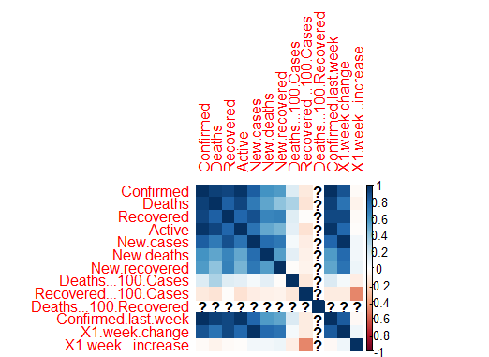
CORRPLOT

Slide 7
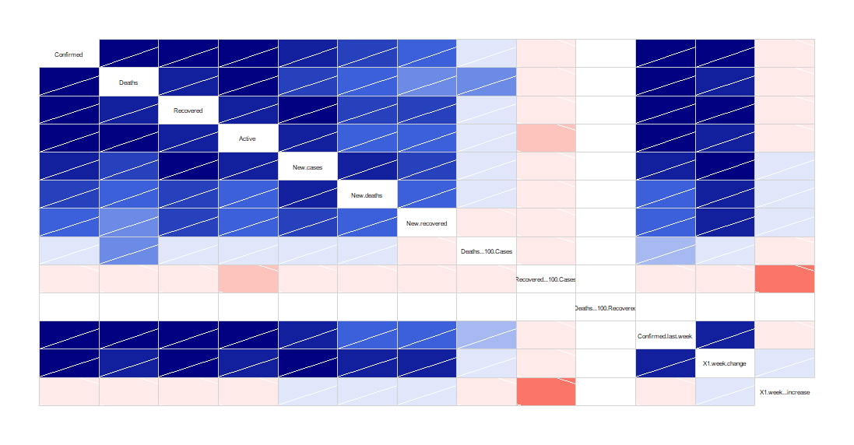
CORRGRAM

